Slide 1
Department of Computer Science & Business Systems SUBJECT: Usability Design of Software Applications Subject Code: Topic Name: Development and Prototyping IV year, Sec: A
Vallurupalli Nageswara Rao Vignana Jyothi Institute of Engineering &Technology
Bhagya Rekha Konkepudi
Assistant Professor
Email: bhagyarekha_k@vnrvjiet.in
<Web link of your created resource if any>

Slide 2
Agenda
Development and Prototyping:
Concept Development
Task flow detailing for the Project
Prototyping Techniques
Paper, Electronic, and Prototyping Tools.

Slide 3
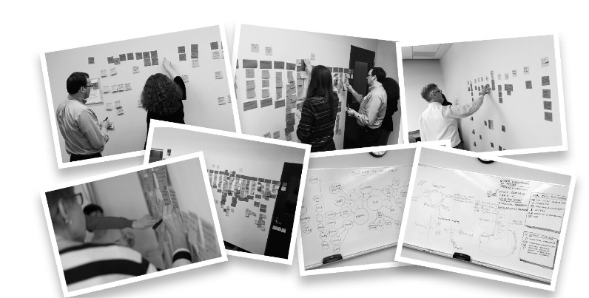
Concept Development
When the initial research phase (more research can be performed ad hoc as needed when questions arise) for a particular area is drawing to a close, the UX designers work with end users to map out the functionality needed in a particular app or function. The research provides the basis for this discussion and helps get all UX designers and end users aligned on assumptions and premises for the work to be done.
Workflow discussions at in-person workshop. Special Interest Group participants working towards a collective vision of the necessary functionality of the area in question and the importance of different potential features.

Slide 4
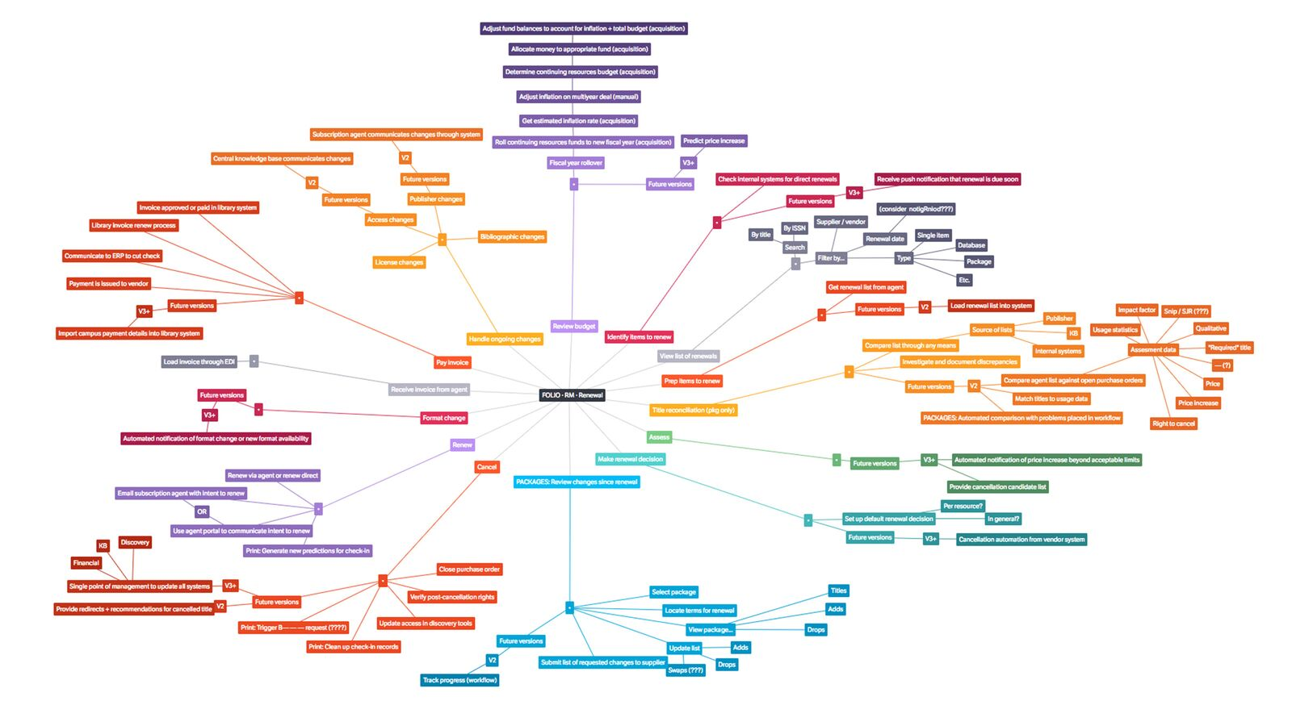
Concept Development
Mapping out the functionality can happen through online meetings, or, as seen above, in in-person workshops. In-person workshops allow for more nuance and create a good team spirit that is sustained in the following online communication. Having an in-person meetup is also a great way to establish a tone of voice and a sense of knowing the other participants in a project or group, which can be challenging if only online meetings occur.
UX designers mapping out functionality to get an overview of the necessary functionality; exploring how it can optimally be structured.

Slide 5
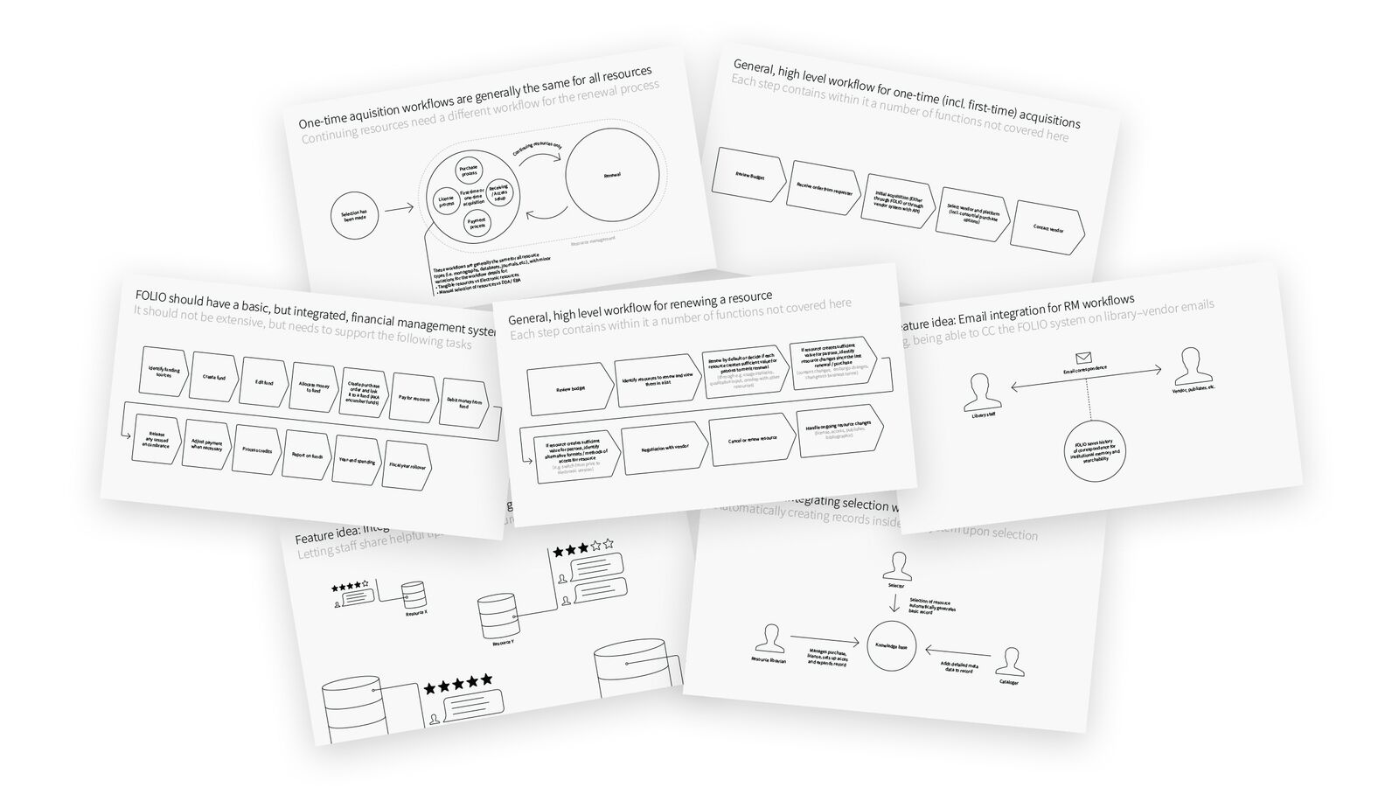
Concept Development
After the workshop or online discussions, UX designers work through the information supplied at the workshop, to form a mental image of what needs to be done and the direction that will take the software there. Various techniques are used, and they vary from UX designer to UX designer.
Summary with provisional conclusions on workflow structures and feature ideas from an in-person workshop and online follow-up meetings

Slide 6
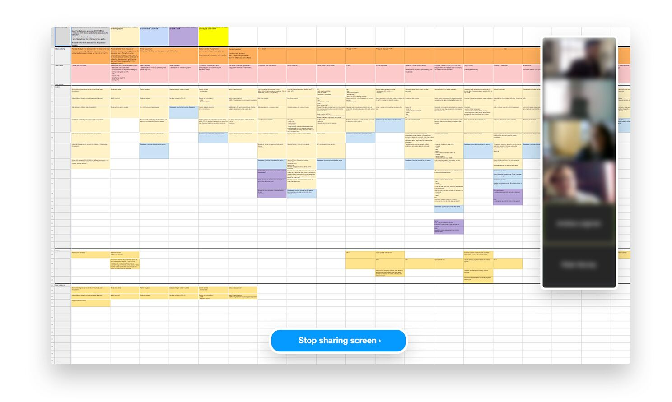
Concept Development
When the findings, advice and ideas from the discussions or workshop have been analyzed, they are summarized and reviewed with the team that attended the workshop. Then adapted if necessary, to make sure they present the consensus reached at the workshop and to make sure everyone feel that the summary is representative of the discussion and conclusions that have taken place.
Online meeting; refining functional mapping from in-person meeting.

Slide 7
Concept Development
Following the workshop, analysis, and summary development, the UX designers work directly with the users through online meetings and written communication to specify what has been discussed. The result is an overview of the necessary functionality in different forms, that can then be used in the next phase of the UX process: Turning the concepts into actual interface designs.

Slide 8
Task Flow Detailing for the project

Slide 9
Task Flow Detailing for the project
Design is a craft. Interactions are fluid and dynamic and, as Interaction Designers, we need to design for all potential permutations within a system to design effective interactions. Designing human-centered interactions is a challenge for those versed in the craft of design, significantly more-so for cross-functional team members who lack formal training in creative problem solving and human-computer interaction.
Luckily, there are techniques that can help! User Scenarios & Task Flows are effective techniques that we can use to align design with behavior, break down complex interactions, and design impactful human-centered interactions that account for the goals, needs, and behaviors of our customers.
The Basics.
To align design with behavior and effectively design human-centered interactions, we first need to understand how end-users relate to the thing that we are designing.

Slide 10
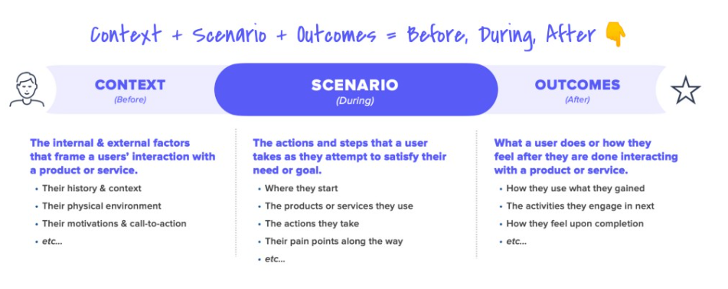
Task Flow Detailing for the project
Human behavior is complex and unpredictable.
To design a Scenario that satisfies a person’s needs, we need to to understand their behavior, and to truly understand their behavior, we need to understand the internal and external factors that shape it — including the Context of their interaction and the Outcomes they are striving to achieve.
Context — A person’s goals, motivations and drivers. The internal and external factors that incite them to action.
Scenario — The actions that a person takes. How they interact with products and services to accomplish their goals.
Outcomes — A person’s state of being after interacting with a product or service. How they feel and what they do next.

Slide 11
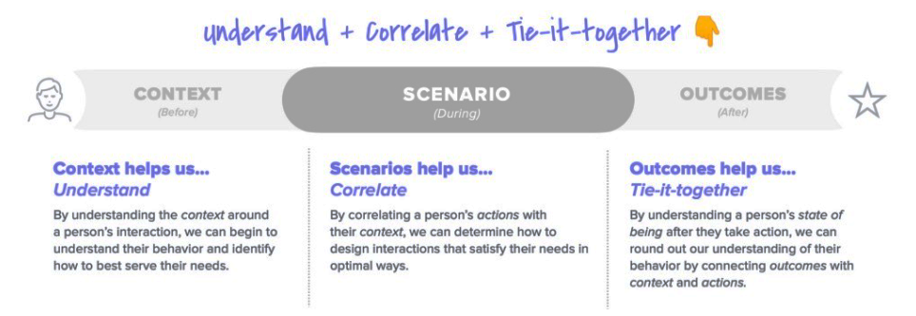
Task Flow Detailing for the project
Understand, Correlate and Tie-it-together.
Context helps us Understand By understanding the context around a person’s interaction, we can better understand their behavior and identify how to best serve their needs.
Scenarios help us Correlate By correlating a person’s actions with their context, we can determine how to design interactions that satisfy their needs in optimal ways.
Outcomes help us Tie-it-together By understanding a person’s state of being after they take action, we can round out our understanding of their behavior by connecting outcomes with context and actions.

Slide 12
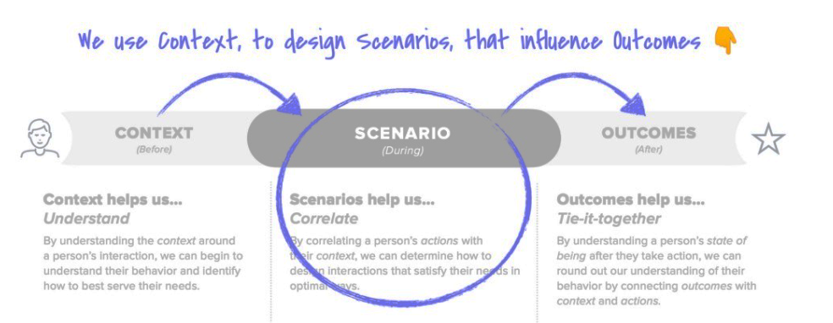
Task Flow Detailing for the project
We use Context, to design Scenarios, that influence outcome.
The work we do as Interaction Designers can be described like this — We use Context, to design Scenarios, that influence outcome.
As an Interaction Designer, the primary output of our work is designing Scenarios — the experience (moments & interactions) a person is immersed in as they interact with a product or service, in the service of attempting to satisfy a need or accomplish a goal.

Slide 13
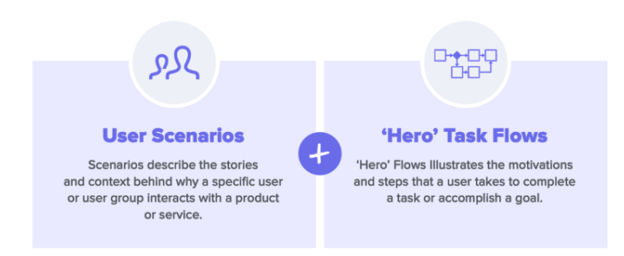
Task Flow Detailing for the project
Integrating user context into our design.
Together, User Scenarios & ‘Hero’ Task Flows help us align design decisions with user behavior — they enable us to understand and articulate our user’s Context, empathize with them, and visualize desirable Outcomes.
User Scenarios — help us empathize with the Context of our users and articulate their goals, motivations, and drivers.
‘Hero’ Task Flows — help us visualize the motivations and primary steps that a user takes as they complete a task or accomplish a goal.

Slide 14
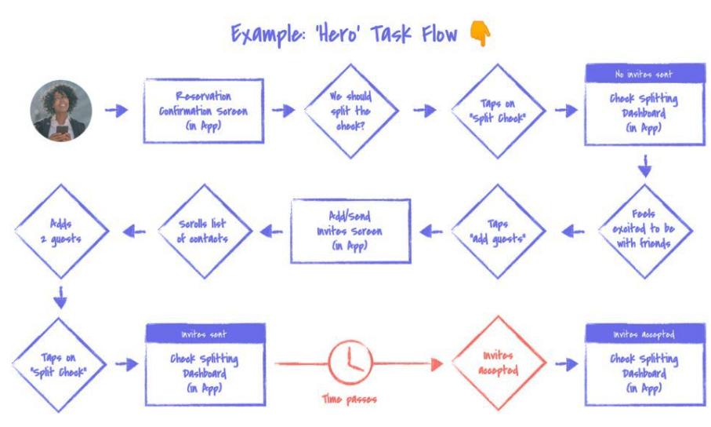
Task Flow Detailing for the project
Technique : ‘Hero’ Task Flows
‘Hero’ Task Flows illustrate the motivations and primary steps that a user takes to complete a task or accomplish a goal.
They help us to visualize the motivations and primary steps that a user takes as they complete a task or accomplish a goal.

Slide 15
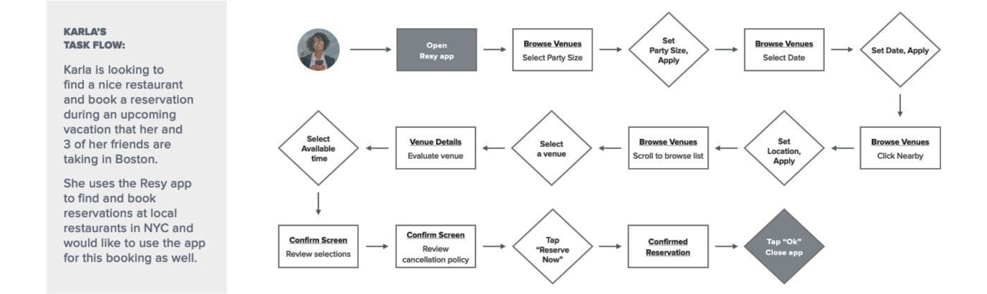
Task Flow Detailing for the project
‘Hero’ Task Flows are a variation of traditional task flows
The difference is that ‘Hero’ Task Flows exclusively focus on the primary motivations and steps required to illustrate how a user goes about completing a goal or task — their “Happy Path”.

Slide 16
Task Flow Detailing for the project
When creating a ‘Hero’ Task Flows, less is more.
Only depict motivations & primary steps — The minimum number of touch points needed to illustrate how a user accomplishes their goal.
Illustrate internal & external touch points — As necessary, incorporate touch points outside of your product or service ecosystem.
Don’t account for edge cases — Focus on the primary path a user takes to achieving their goal. Define the edge cases later.
When, how, and why do we use User Scenarios and ‘Hero’ Task Flows?
User Scenarios + ‘Hero’ Flows can be utilized at both ends of the design process. Early, when we are identifying things to build and later, when we are figuring out how to build something effectively.

Slide 17
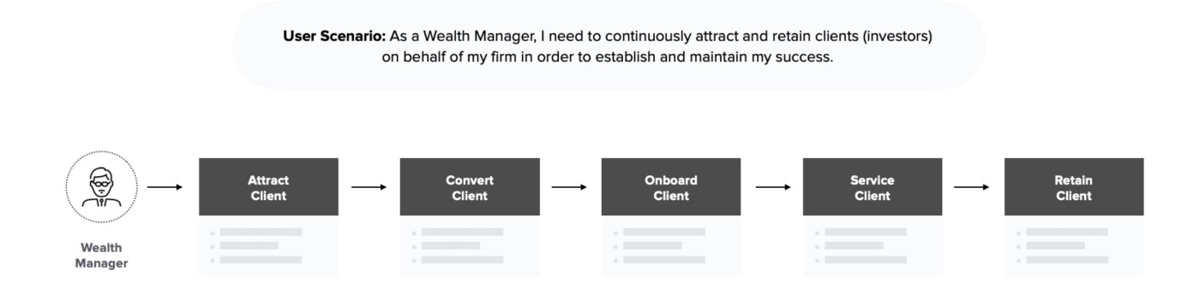
Task Flow Detailing for the project
01. / User Scenarios & Task Flows — Early in the design process.
When we are determining “What to build”, User Scenarios & Task Flows are broad, less detailed, and cover more of a journey.
‘Hero’ Task Flows are most commonly used early in the design process, when we are thinking broadly about the design of an experience.

Slide 18
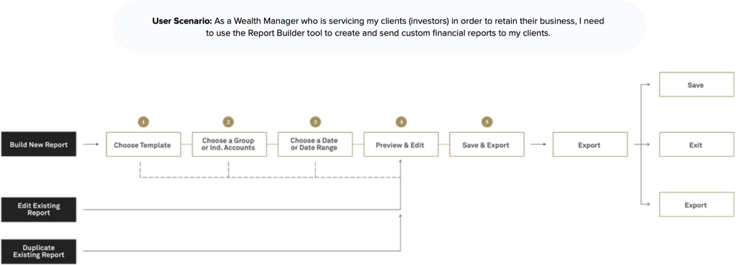
Task Flow Detailing for the project
02. / User Scenarios & Task Flows — Later in the design process.
When we are determining “How to build” something, User Scenarios & Task Flows are more specific, detailed, and cover less of a journey.
As we get more specific and detailed in the design of our experience, our ‘Hero’ Task Flows evolve and become traditional Task Flow diagrams.

Slide 19
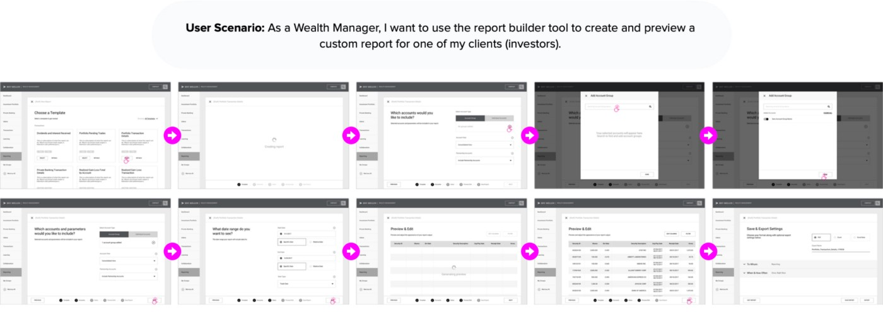
Task Flow Detailing for the project
03. / User Scenarios & Task Flows — At the end of the design process.
When we are finalizing “How to build” something, User Scenarios & Task Flows are very specific, detailed, and cover specific aspects of a journey.
As we finalize design of our experience, our Task Flows diagrams can evolve into granular Screen Flow Diagrams or functional prototypes.

Slide 20
Task Flow Detailing for the project
03. / User Scenarios & Task Flows — At the end of the design process.
When we are finalizing “How to build” something, User Scenarios & Task Flows are very specific, detailed, and cover specific aspects of a journey.
As we finalize design of our experience, our Task Flows diagrams can evolve into granular Screen Flow Diagrams or functional prototypes.

Slide 21
Task Flow Detailing for the project
Step-by-step: How to use User Scenarios and ‘Hero’ Task Flows to integrate user context early in the design process.
The real-world example below shows how we can use User Scenarios and ‘Hero’ Task Flows to align design decisions with user behavior by articulating the Context and Goals of our user.
In this example, we are designing an iOS App feature that allows users who have booked a restaurant reservation using the Reserve app to split the check with friends and pay for their meal digitally, through the app.

Slide 22
Task Flow Detailing for the project
Step-by-step: How to use User Scenarios and ‘Hero’ Task Flows to integrate user context early in the design process.
Step 01: Gain an understanding of your user.
A prerequisite to defining User Scenarios and ‘Hero’ Task Flows is a baseline understanding of the user you are designing for — this includes, but is not limited to, their Status, Context and Goals while interacting with the product, service, or feature you are designing.
This understanding can be acquired by talking, listening or observing users via a variety of UX research methodologies including interviews, surveys, or contextual inquiry.

Slide 23
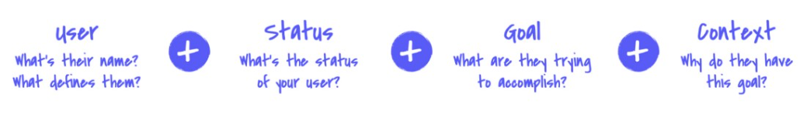
Task Flow Detailing for the project
Step 02: Draft a User Scenario.
To get started, draft a User Scenario that frames how and why a user would use the thing that you are designing.
A simple framework can be used as a guide to help you and your team write effective User Scenarios — User + Status + Goal + Context.
User — What is their name? What attributes define them in this context?
Status — What is their status within the system?
Goal — What is their goal? What are they trying to accomplish?
Context — Why do they have this goal? What motivates them?

Slide 24
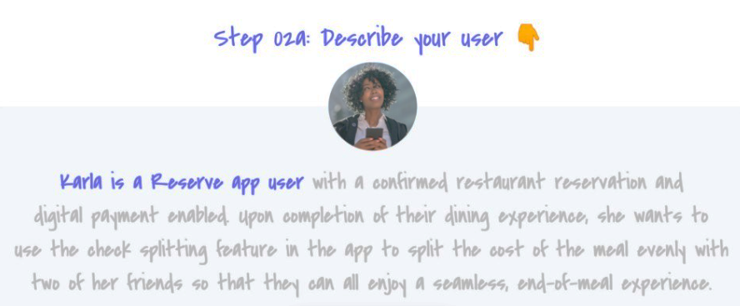
Task Flow Detailing for the project
Step 02a: Draft a User Scenario — Describe your user.
First, give your user a name, then describe the attributes that define who they are within the context of their interaction with the system you are designing.
In the example below we have given our user a name, Karla, then associated her with the attribute that defines her within the ecosystem — She is a Reserve App User.

Slide 25
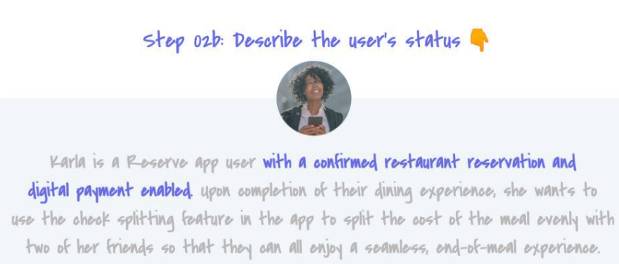
Task Flow Detailing for the project
Step 02b: Draft a User Scenario — Describe the user’s status.
Next, describe the status of your user within the context of their interaction with the system you are designing. What is their status within this system?
In the example below, we are describing Karla’s current status as a user within the Reserve App ecosystem — In this scenario she has a confirmed restaurant reservation and digital payment enabled.

Slide 26
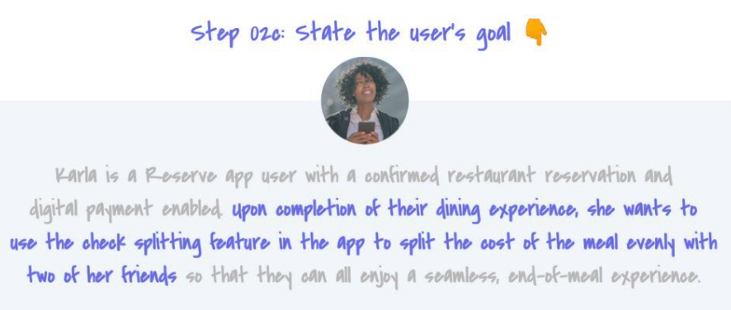
Task Flow Detailing for the project
Step 02c: Draft a User Scenario — State the user’s goal.
Now, state the goal that your user has within the context of their interaction with the system you are designing — What are they trying to accomplish? What does success look like for them?
In the example below, we have already established Karla’s status within the Reserve ecosystem — she is an “App user with a confirmed restaurant reservation and digital payment enabled”.
Her goal builds upon her status — Upon completion of their dining experience, she wants to use the check splitting feature in the app to split the cost of the meal evenly with two of her friends.

Slide 27
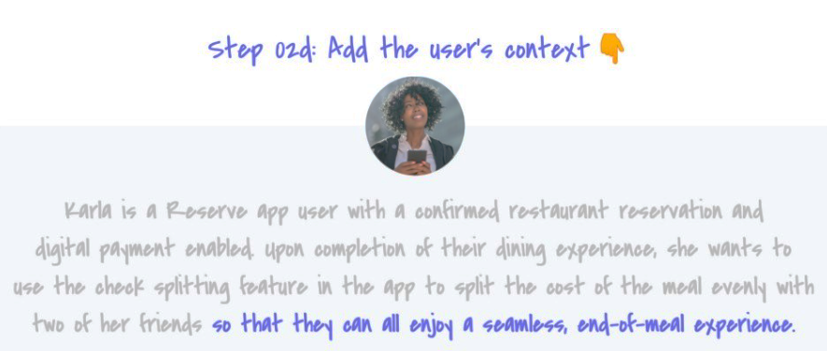
Task Flow Detailing for the project
Step 02d: Draft a User Scenario — Add the user’s context.
Finally, describe the context of your user within the system you are designing. Why do they have this goal? What is motivating them to achieve this goal?
In the example below, we are describing why Karla is motivated to complete her goal of using the check splitting feature in the Reserve App to split the cost of the meal evenly with two of her friends — she wants them all to enjoy a seamless, end-of-meal experience.

Slide 28
Task Flow Detailing for the project
Step 03: Sketch a ‘Hero’ Task Flow.
Next, using your User Scenario as a framing mechanism, define a ‘Hero’ Task flow that illustrates the motivations and primary steps that your user takes to accomplish the goal defined in your Scenario.
Both action and emotion can be reflected in a ‘Hero’ Task flow.
Starts — Where they start their journey.
Thinks — What they are thinking before they take an action.
Does — An action they take.
Arrives — The destination they arrive at after taking an action.
Feels — How they feel upon arrival, or before or after taking an action.

Slide 29
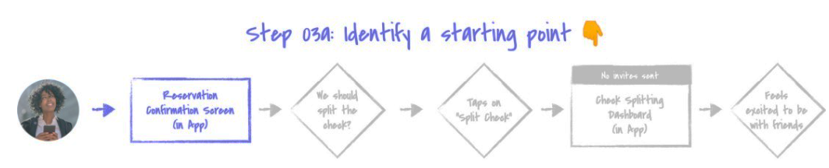
Task Flow Detailing for the project
Step 03a: Sketch a ‘Hero’ Task Flow — Identify a starting point.
To get started, identify where your user starts their journey.
In the example below, based on her status in the system, Karla starts her journey on the Reservation Confirmation Screen in the Reserve app.

Slide 30
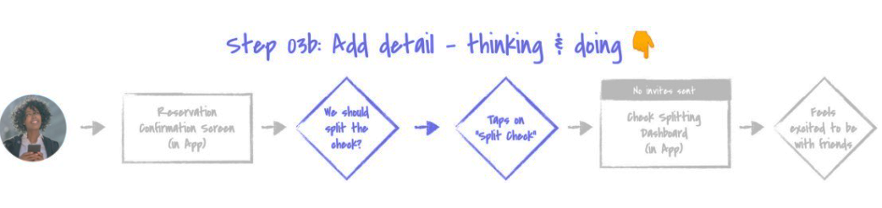
Task Flow Detailing for the project
Step 03b: Sketch a ‘Hero’ Task Flow — Add detail, thinking & doing.
Next, add detail — based on their context and goal, what are they thinking? What action do they take next?
in the example below, based on her context and goal, Karla is thinking about how she wants to split the check with two of her friends at her upcoming restaurant reservation. In response to this, she taps on an affordance in the Reserve app to split the check.

Slide 31
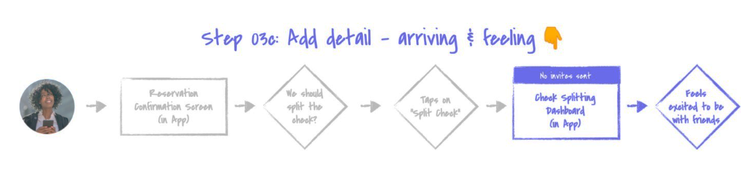
Task Flow Detailing for the project
Step 03c: Sketch a ‘Hero’ Task Flow — Add detail, arriving & feeling.
Now, add more detail — after taking an action, what screen or state do they arrive at? How do they feel upon arrival?
In the example below, after tapping on the split the check affordance, Karla arrives on the Check Splitting Dashboard in the Reserve App. At this point, Karla is feeling excited, she is looking forward to sharing a meal with her friends!
Karla’s context should guide how we design this feature, we want to make sure that we make splitting the check easy and fun for Karla so that she is focused on enjoying a meal with her friends, not our App.

Slide 32
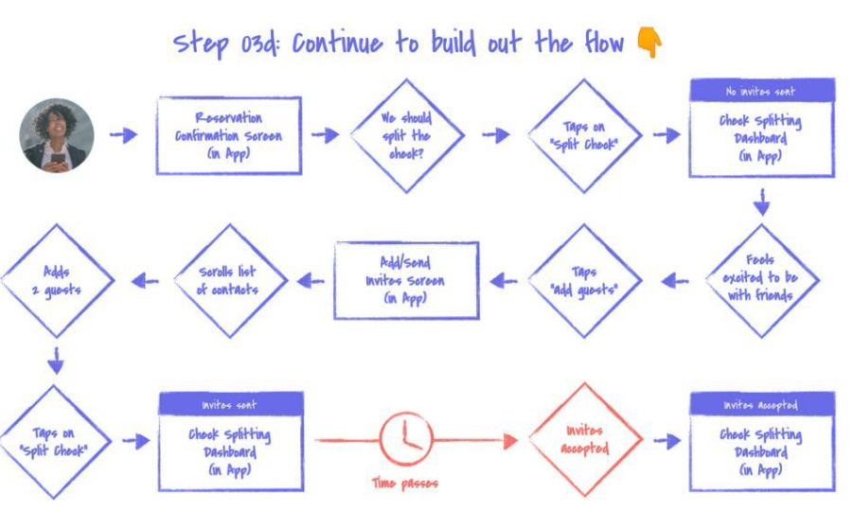
Task Flow Detailing for the project
Step 03d: Sketch a ‘Hero’ Task Flow — Continue to build out the flow.
Next, repeat the steps above for the remainder of your user’s ‘Hero’ flow — based on their context and goal, what are they thinking? What action do they take next? Where do they arrive? How do they feel upon arrival?
In the example below, we are showing the remainder of Karla’s ‘Hero’ flow through the Reserve Check Splitting feature — this includes using the app to send invites to her friends, awaiting their response, and the subsequent moments that follow.

Slide 33
Task Flow Detailing for the project
Elements, Functionality and States — designing systems, not just screens.
To design for all potential permutations within a system and define how the components within a system impact each other, we need to have an in-depth understanding of the Complexity (Elements & Functionality) and Variants (States) that exist within the system we are designing.
Screens vs. Elements, Functionality and States.
Screens (or templates, pages, etc…) are nothing more than containers. They are a collection of Elements and Functionality that can appear in numerous States.
To think beyond static Screens and design for user interaction, we first need to understand the components that a screen is comprised of — Elements, Functionality and States.
Elements — The content and user interface (UI) elements contained within a screen.
Functionality — The actions a user can take within a screen to navigate or alter the state of elements.
States — Alternative screen views where elements are changed based on user or system-defined variables.

Slide 34
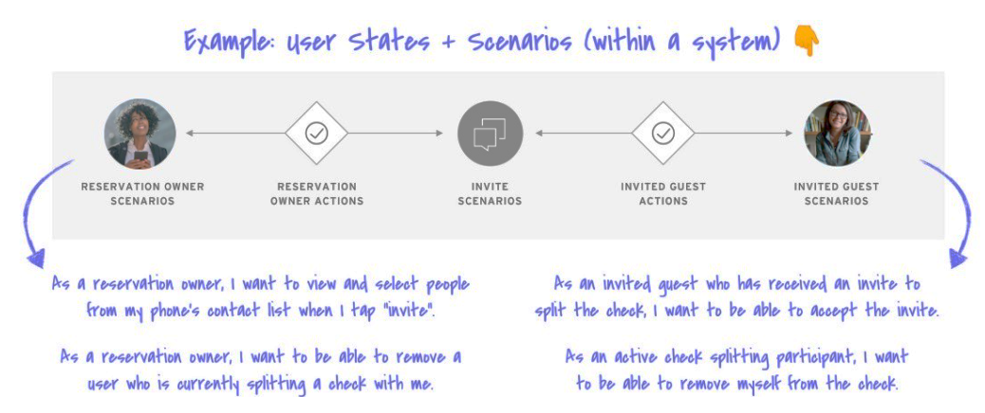
Task Flow Detailing for the project
Utilizing User Scenarios and ‘Hero’ Task Flows as framing tools for ideation.
We can utilize User Scenarios and ‘Hero’ Task Flows to gain an understanding of the Context of an end-user (or users) relationship with a system.
This Context enables us understand the complexity and nuance of the relationship — What are the different States that a user can take on within the system? How and when does a users State change or evolve over time? How does the system need to flex or adapt to accommodate State changes?
Using Context, we can define the Elements, Functionality and States within a system with deeper awareness and intention. We can ideate at a deeper level to define how the system may appear or behave differently based on the state a user is in when interacting with it.

Slide 35
Prototyping

Slide 36
Prototyping
For users to evaluate the design of an interactive product effectively, designers must prototype their ideas. In the early stages of development, these prototypes may be made of paper and cardboard, or ready-made components pulled together to allow evaluation, while as the design progresses, they become more polished, compact, and robust so that they resemble the final product.
A prototype is one manifestation of a design that allows stakeholders to interact with it and to explore its suitability; it is limited in that a prototype will usually emphasize one set of product characteristics and de-emphasize others.
prototype can also be a paper-based outline of a display, a collection of wires and ready-made components, an electronic picture, a video simulation, a complex piece of software and hardware, or a three dimensional mockup of a workstation.

Slide 37
Prototyping
Prototypes are useful when discussing or evaluating ideas with stakeholders; they are a communication device among team members and an effective way for designers to explore design ideas. The activity of building prototypes encourages reflection in design, as described by Schön (1983), and is recognized by designers from many disciplines as an important aspect of design.
Prototypes answer questions and support designers in choosing between alternatives. Hence, they serve a variety of purposes:
To test out the technical feasibility of an idea,
To clarify some vague requirements,
To do some user testing and evaluation, or
to check that a certain design direction is compatible with the rest of the product development.
The purpose of your prototype will influence the kind of prototype you build. So, for example, if you want to clarify how users might perform a set of tasks

Slide 38
Prototyping
Prototyping
Low-Fidelity Prototyping
Storyboarding
Sketching
High-Fidelity Prototyping
Prototyping with index cards
Wizard of Oz.
Clickable Wireframes

Slide 39
Low-Fidelity Prototyping
A low-fidelity prototype does not look very much like the final product and does not provide the same functionality.
For example, it may use very different materials, such as paper and cardboard rather than electronic screens and metal, it may perform only a limited set of functions, or it may only represent the functions and not perform any of them.
The lump of wood used to prototype the PalmPilot described above is a low-fidelity prototype.
Low-fidelity prototypes are useful because they tend to be simple, cheap, and quick to produce. This also means that they are simple, cheap, and quick to modify so they support the exploration of alternative designs and ideas.
This is particularly important in the early stages of development, during conceptual design for example, because prototypes that are used for exploring ideas should be flexible and encourage exploration and modification. Low-fidelity prototypes are not meant to be kept and integrated into the final product. They are for exploration only.

Slide 40
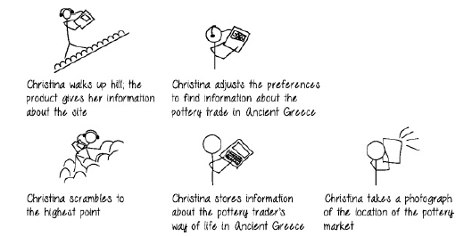
Low-Fidelity Prototyping
Storyboarding.
Storyboarding is one example of low-fidelity prototyping that is often used in conjunction with scenarios. A storyboard consists of a series of sketches showing how a user might progress through a task using the product under development.
It can be a series of screen sketches or a series of scenes showing how a user can perform a task using
an interactive device. When used in conjunction with a scenario, the storyboard provides more detail and offers stakeholders a chance to roleplay with a prototype, interacting with it by stepping through the scenario.
The example storyboard shown in Figure depicts a person (Christina) using a new mobile device for exploring historical sites. This example shows the context of use for this device and how it might support Christina in her quest for information about the pottery trade at The Acropolis in Ancient Greece.

Slide 41
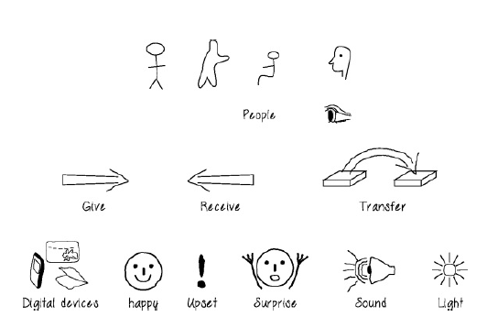
Low-Fidelity Prototyping
Sketching.
Low-fidelity prototyping often relies on hand-drawn sketches, and many people find it difficult to engage in this activity because they are inhibited about the quality of their drawing, but as Greenberg et al (2012) put it,
“Sketching is not about drawing. Rather, it is about design” (p. 7). You can get over any inhibition by devising your own symbols and icons and practicing them – referred to by Greenberg et al as a ‘sketching vocabulary’ (p. 85).
They don't have to be anything more than simple boxes, stick figures, and stars. Elements you might require in a storyboard sketch, for example, include digital devices, people, emotions, tables, books, etc., and actions such as give, find, transfer, and write. If you are sketching an interface design, then you might need to draw various icons, dialog boxes, and so on.
Some simple examples are shown in Figure The next activity requires other sketching symbols, but they can still be drawn quite simply. Baskinger (2008) provides further tips for those new to sketching.

Slide 42
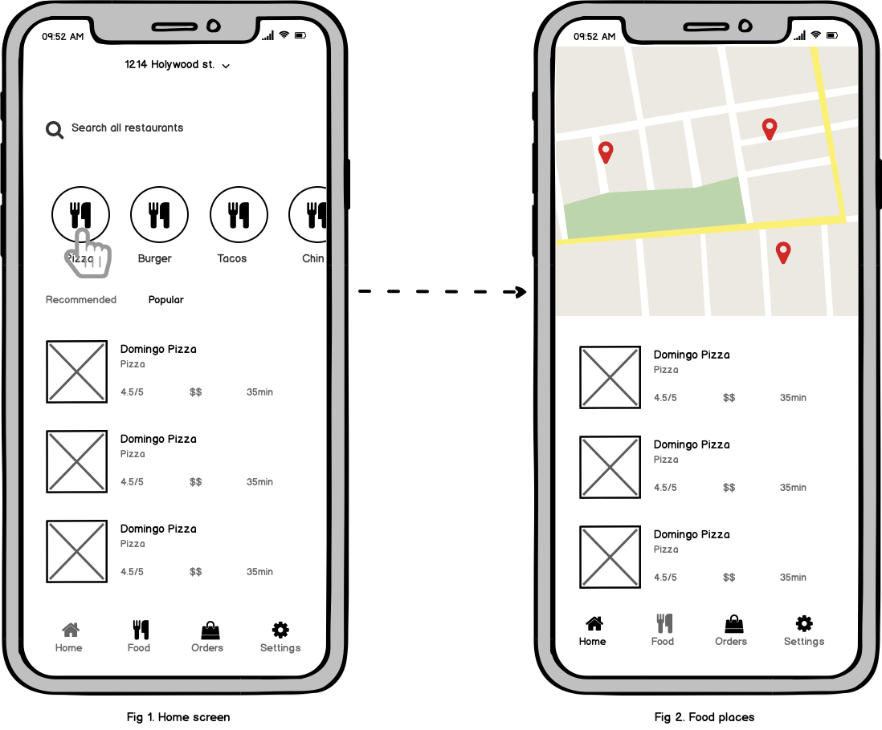
Low-Fidelity Prototyping
Clickable Wireframes
Clickable wireframes are the simplest form of an interactive prototype created by linking several static wireframes together. Each wireframe contains only the key elements (content blocks and functional elements).
When to use: Clickable wireframes work best during the early stages of design process — when you want to design a few different versions of your design within a particular design direction.
Pros:
Doesn’t require any advanced prototyping skills. No matter what prototyping tool you want to use, it’s possible to create a clickable wireframe without much effort.
Easy to modify. Unlike a paper prototype, you don’t need to redraw a whole page/screen to introduce changes.
Cons:
Require explanation. You need to bring imagination to understand how the finished product will look and work.
Tip: It’s possible to create clickable wireframes in Power Point or Keynote. Simply link together different pages to create a clickable flow.

Slide 43
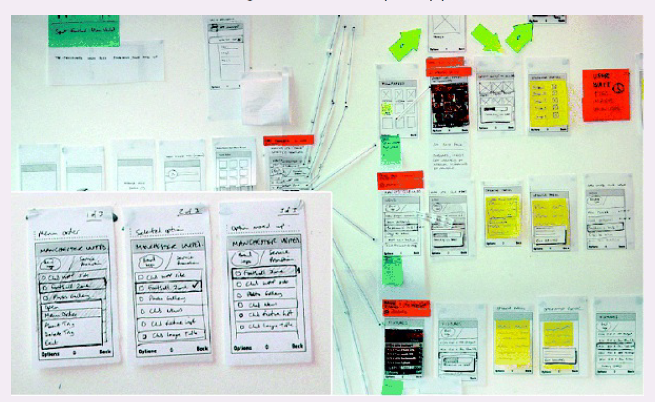
Low-Fidelity Prototyping
Prototyping with index cards.
Using index cards (small pieces of cardboard about 3 × 5 inches) is a successful and simple way to prototype an interaction, and is used often when developing websites.
Each card represents a screen or one element of the interaction. In user evaluations, the user can step through the cards, pretending to perform the task while interacting with the cards.

Slide 44
Low-Fidelity Prototyping
Wizard of Oz.
Another low-fidelity prototyping method called Wizard of Oz assumes that you have a software-based prototype. In this technique, the user interacts with the software as though interacting with the product. In fact, however, a human operator simulates the software's response to the user.
The method takes its name from the classic story of the little girl who is swept away in a storm and finds herself in the Land of Oz (Baum and Denslow, 1900). The Wizard of Oz is a small shy man who operates a large artificial image of himself from behind a screen where no one can see him.
The Wizard of Oz style of prototyping has been used successfully for various applications, including Pin Trace, a robotic system that helps surgeons to position orthopedic pins accurately during the surgery of hip fractures (Molin, 2004), and to identify gestures for full body interaction with digital games (Norton et al, 2010).

Slide 45
High-Fidelity Prototyping
A high-fidelity prototype looks like the final product and/or provides more functionality than a low-fidelity prototype.
For example, a prototype of a software system developed in Visual Basic is higher fidelity than a paper based mockup; a molded piece of plastic with a dummy keyboard is a higher-fidelity prototype of the PalmPilot than the lump of wood.
High-fidelity prototyping is useful for selling ideas to people and for testing out technical issues.
High-fidelity prototypes can be developed by modifying and integrating existing components – both hardware and software.
In robotics this approach has been called tinkering (Hendriks-Jansen, 1996) while in software development it has been referred to as Opportunistic System Development (Ncube et al, 2008). Banzi (2009) comments that: “Reusing existing technology is one of the best ways of tinkering. Getting cheap toys or old discarded equipment and hacking them to make them do something new is one of the best ways to get great results.”
Bird et al (2009) describe how they used this approach to develop a tactile vision sensory substitution system, i.e. a system that translates a camera image of the user’s environment into tactile stimulation on their body.

Slide 46
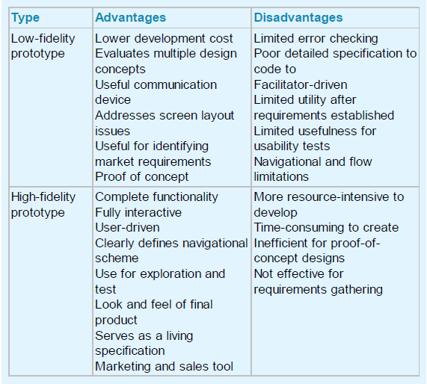
Prototyping

Slide 47
The 9 best prototyping tools for UI/UX designers in 2022
Prototyping is a crucial step in the UX design process. And, like anything in UX, there are countless tools out there to help you get the job done.
If you’re spoiled for choice and struggling to narrow it down, this guide is for you. We’ve compiled the 9 best UI UX prototyping tools for UX designers, complete with an explanation of how they work.
When you get to the end, you’ll also find some tips on how to choose the right prototyping tool for your needs.

Slide 48
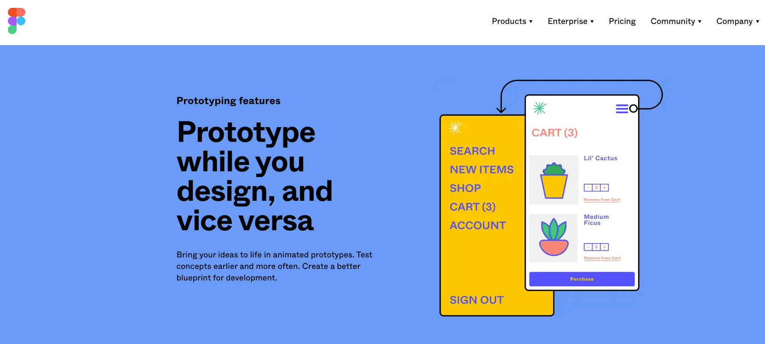
The 9 best prototyping tools for UI/UX designers in 2022
1. Figma
Figma is an all-in-one design tool, handling everything from wireframing, prototyping and UI design to collaboration, design system management, and developer handoff.
With Figma, you can turn static design files into interactive prototypes—no coding knowledge required.
With the intuitive builder, you can simply connect various UI elements and choose your interactions and animations. Once you’ve built your prototype, you can view it on mobile using the Figma app (available for iOS and Android), or share a link to view it in the browser.
Learn more about prototyping with Figma here.

Slide 49
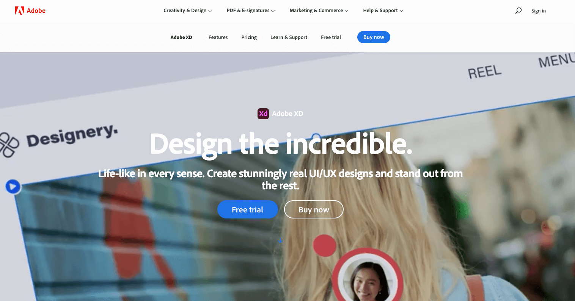
The 9 best prototyping tools for UI/UX designers in 2022
2. Adobe XD
Adobe XD is a powerful vector-based tool used for collaborative design and prototyping.
How does Adobe XD work as a prototyping tool?
With Adobe XD, there are 2 modes you can work in: Design mode and Prototype mode. In Design mode, you create static designs, adding various elements to artboards. Artboards represent the different app screens or website pages.
To turn your static designs into interactive prototypes, you then switch to Prototype mode. Here, you can draw interactive links between your artboards (i.e. screens) to simulate the flow of your website or app.
You can share your prototype with others via a URL or embed code. If you enable the commenting function, stakeholders can give feedback directly in the prototype.
You can learn more about how to create interactive prototypes with Adobe XD here.

Slide 50
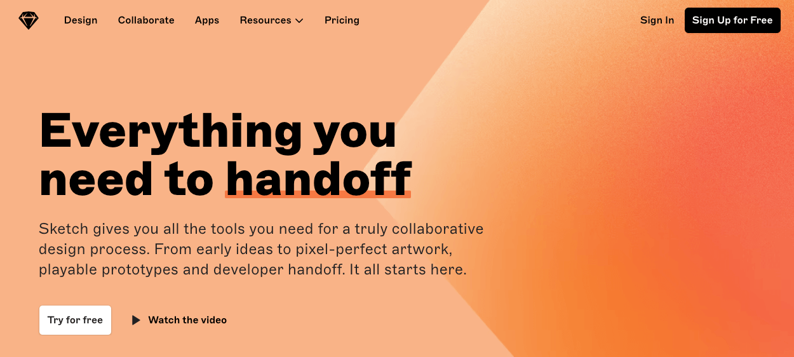
The 9 best prototyping tools for UI/UX designers in 2022
3. Sketch
Sketch is another all-in-one digital design platform used for creating static designs and prototypes, and for developer handoff.
First, you create your static designs in Canvas using Sketch’s flexible vector editing tools. You then use the prototyping function to preview your designs and navigate between Artboards (i.e. screens) with animated interactions.
The quickest way to turn your static screens into interactive prototypes in Sketch is to add links between two Artboards. You can then fine-tune your prototypes by adding Hotspots (clickable areas), fixing certain elements in place, and setting start points to determine which Artboard your prototype starts with when you preview it.
There are 3 ways to preview your Sketch prototypes: directly in the Sketch app (for Mac), via the Sketch Mirror app on an iOS device, or in the web app.
You can learn more about how to use Sketch’s prototyping tools here.

Slide 51
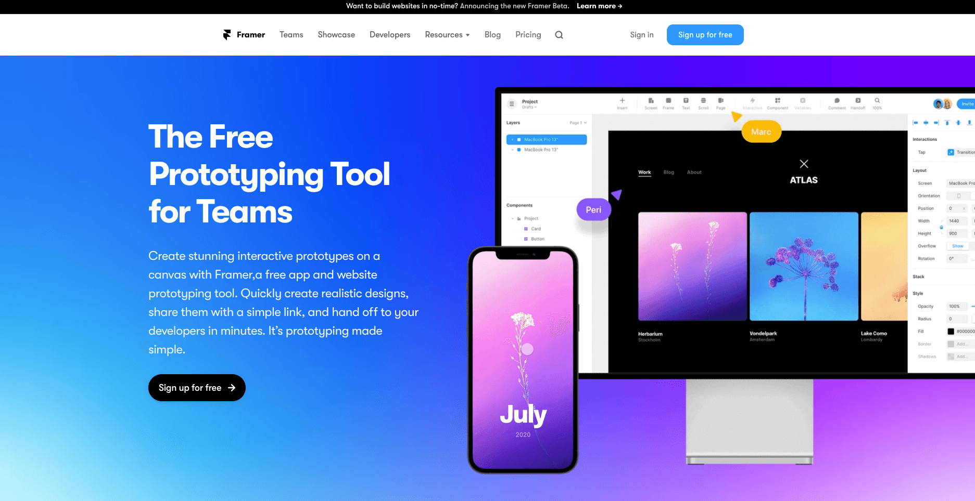
The 9 best prototyping tools for UI/UX designers in 2022
4. Framer
Framer is a free app and website prototyping tool ideal for quickly creating realistic, high-fidelity designs and animations.
With Framer, you can create interactive prototypes by dragging and dropping pre-made interactive components and building in animations and transitions. Based on your designs, Framer generates code-based prototypes that behave and feel just like a real app or website.
Framer has loads of tools and features for building out rich prototypes, including adaptive layouts that serve as the foundation for your design, fully customizable interactive components, and built-in tools for paging, scrolling, and navigation.
You can also create Magic Motion transitions where layers that exist on both the transition’s origin and its target will animate into their new style and positions.
In a nutshell, Framer is all about rapid, high-fidelity prototyping via ready-made components and user-friendly drag-and-drop functionality.
For a beginner’s guide to prototyping with Framer, check out this tutorial.

Slide 52
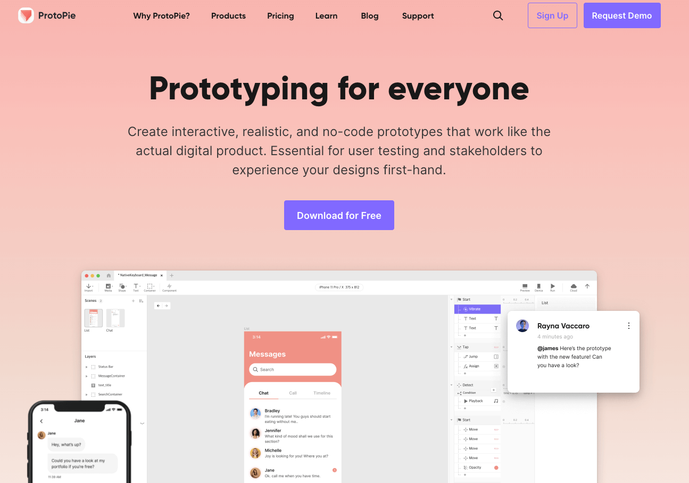
The 9 best prototyping tools for UI/UX designers in 2022
5. ProtoPie
ProtoPie is a flexible yet powerful prototyping tool praised among the design community for its easy-to-use interface and almost non-existent learning curve.
Unlike some other tools on our list, ProtoPie focuses solely on prototyping, so you’ll need to import your static designs from another tool first. ProtoPie has plugins for Figma, Adobe XD and Sketch.
Once you’ve imported your wireframes, you turn them into interactive prototypes by adding triggers, responses, and objects. The trigger is the user action that will “cause” the interaction. The object is the element that the user will interact with in order to set the trigger in motion. The response is the result of the interaction—for example, opening a link or jumping to another page. You can build these interactions by simply selecting pre-made triggers and responses from the drop-down menu in the toolbar.
From there, you can use a range of additional features and tools to make your interactions more complex and precise. You can then preview your prototypes in the preview window, upload them to the cloud and share a link, or generate a QR code which you can scan in order to view the prototype using your smartphone.

Slide 53
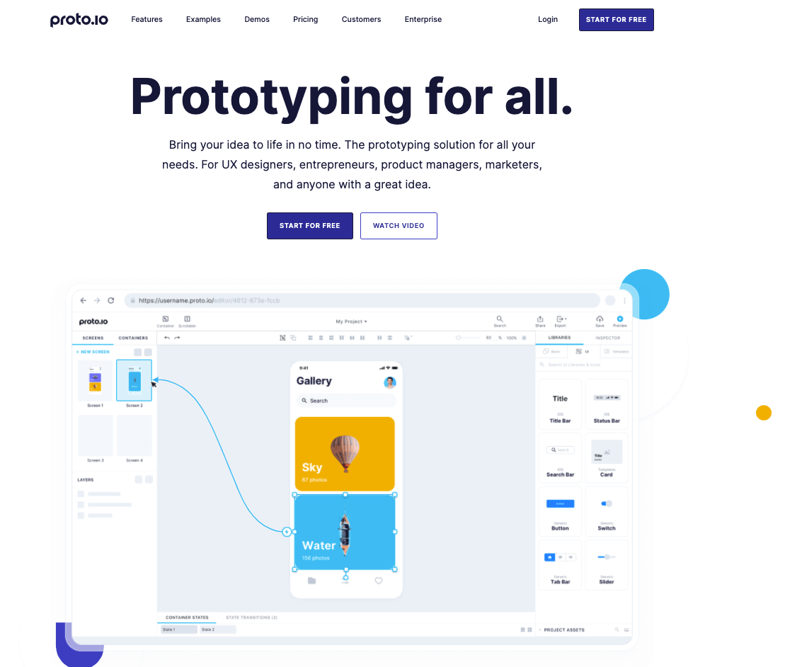
The 9 best prototyping tools for UI/UX designers in 2022
6. Proto.io
Proto.io is a browser-based prototyping tool with an intuitive drag-and-drop interface and hundreds of ready-made templates and components.
Proto.io lets you quickly put together basic low-fidelity prototypes which you can later transform into more realistic high-fi prototypes.
If you want to start by creating low-fi wireframes from scratch, you first need to select the device/screen size you want to design for, then add basic UI elements from the extensive UI library. Alternatively, you can customise a ready-made template. You can also import existing wireframes from Sketch, Adobe XD, Figma and Photoshop.
To turn your basic wireframes into prototypes, you use the Proto.io interaction wizard to add motion and interactive properties. You can add connectors between one screen and another, customise the type of transition via the drop-down menu, and polish up your prototypes with over 6,000 ready-to-use digital assets and animations.
Prototypes can be viewed in preview mode, downloaded and tested in the Proto.io mobile app, and shared via a public URL.

Slide 54
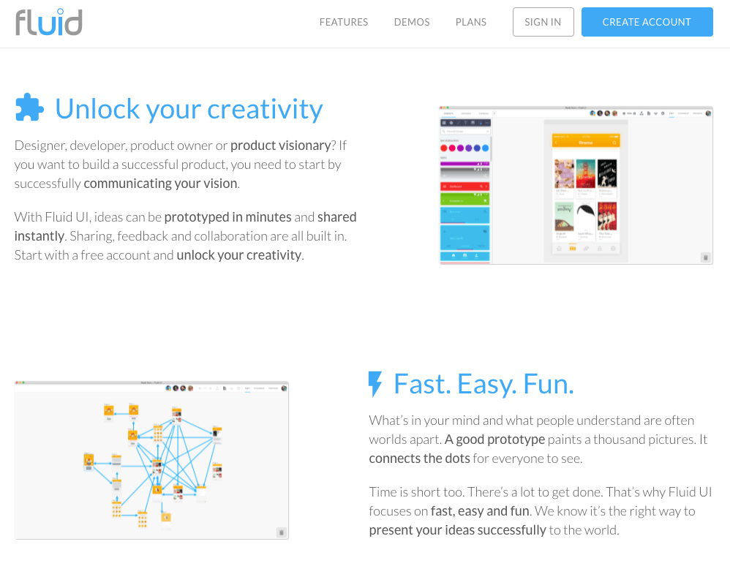
The 9 best prototyping tools for UI/UX designers in 2022
7. Fluid UI
Fluid UI is a rapid prototyping tool with extensive component libraries, easy animations, and real-time collaboration.
The entire Fluid UI platform is built for speed. You can create prototypes in minutes with over 2,000 ready-to-use components, with libraries for Material Design, iOS, and Windows. You can also upload existing assets.
With the user-friendly linking system, you can add mouse and touch gestures and unique animations, and convey the flow of your website or app.
You’ll also find lots of handy features for collaboration and feedback, including live video calling, video presentations, and built-in commenting.

Slide 55
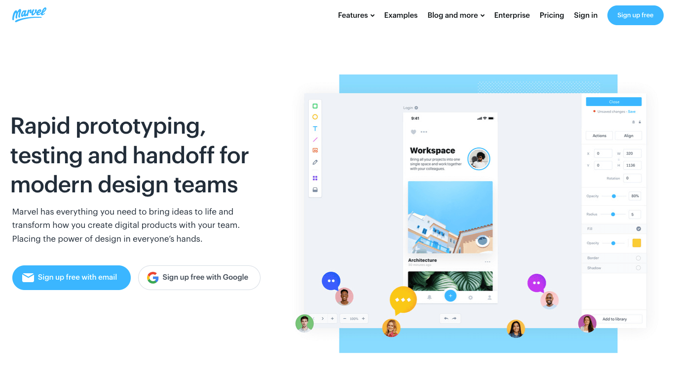
The 9 best prototyping tools for UI/UX designers in 2022
8. Marvel
Marvel is a rapid prototyping, testing and handoff tool for digital designers, endorsed by companies such as Nokia, Monzo, BuzzFeed and Deliveroo.
To prototype with Marvel, you can either import existing static designs which you’ve created elsewhere, or create wireframes from scratch using pre-made elements and icons. Alternatively, you can use the Sketch plugin to directly sync Sketch files.
Marvel’s prototyping tool is relatively straightforward. With your static designs ready, just hover over any file within your project and click “Prototype”. This will take you to the editor, where you can create hotspot links (interactive areas that are drawn on top of your designs to enable users to click or tap to move between screens), and add effects, transitions and gestures.
To preview your prototype, simply close the editor and press “Play” in the project view. This will take you to Play mode, where you can click around and interact with your prototype as if it’s a live product. Once you’re happy, you can share your prototype for feedback and put it in front of real users for testing.

Slide 56
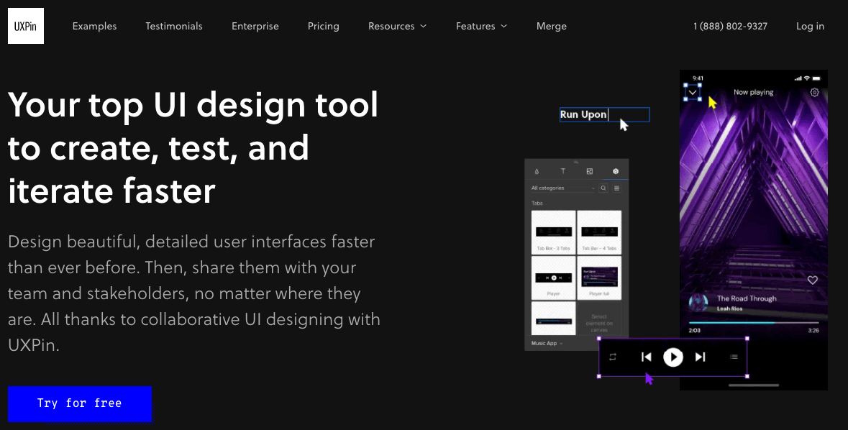
The 9 best prototyping tools for UI/UX designers in 2022
9. UXPin
UXPin is a robust end-to-end design platform with powerful prototyping capabilities. It’s arguably one of the best tools out there for creating high-fidelity, true-to-life prototypes. When prototyping with UXPin, you can either start from scratch or import existing designs from Sketch or Photoshop, as well as static PNG or JPG files.
Your prototypes are nested within projects, so you can navigate to the project view to see an overview of all your prototypes, as well as an activity feed on the right-hand side to see who’s working on what.
Once you’re working on a prototype, you’ll find that the UXPin interface is fairly similar to Sketch and Photoshop: a blank canvas in the middle and then various tools, shapes and icon libraries on the right and left-hand sides.
If you’re designing from scratch, you can use the pen tool and shapes to add the basic UI elements. From there, you can draw out clickable hotspot areas to add interactivity, insert ready-made elements and build out advanced interactions such as button hovers, expandable menus and conditional navigation flows.
You’ll end up with fully clickable prototypes which, depending on their visual fidelity, can feel almost indistinguishable from a real, live product.

Slide 57
Introduction to Physical Computing
Physical Computing is the process of building interactive physical systems that can sense and respond to the world using hardware and software.
Key Idea: It bridges the gap between the physical world (sensors, actuators) and the digital world (programs, data, cloud).
Examples:
Smart doorbell that detects motion and sends alerts.
Heart-rate monitor connected to a smartwatch.
Arduino-based automatic plant watering system.

Slide 58
Introduction to Physical Computing
Components of Physical Computing
1. Input Devices (Sensors): Collect data from the environment — e.g., temperature, pressure, light, sound. Examples: DHT11 sensor, LDR, Ultrasonic sensor.
2. Processing Unit (Microcontroller): Interprets the sensor data and takes decisions. Examples: Arduino Uno, Raspberry Pi, ESP32.
3. Output Devices (Actuators): Perform physical actions — e.g., turning on a fan, lighting LEDs, or moving a motor. Examples: Servo motor, LED matrix, buzzer.

Slide 59
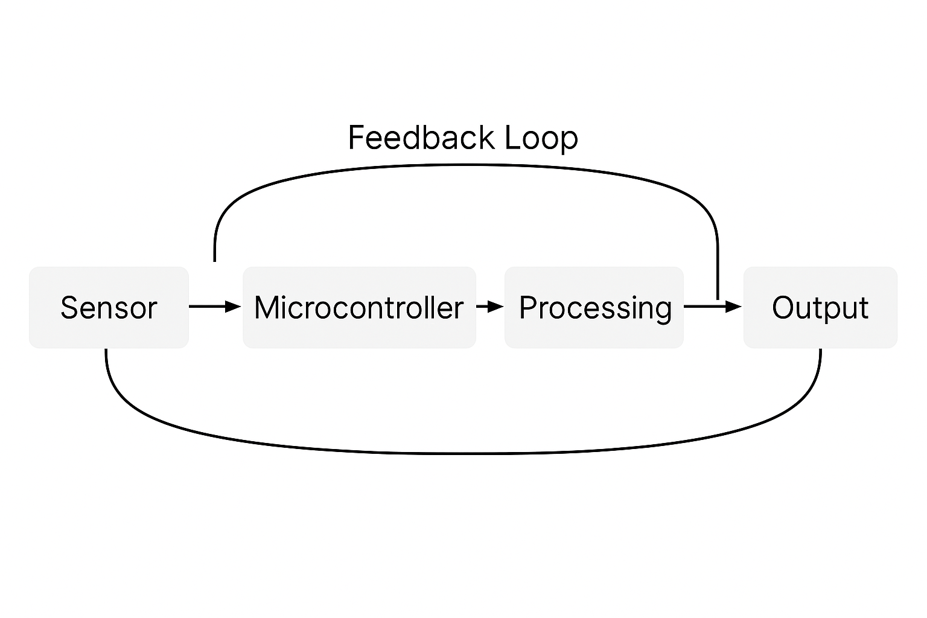
Introduction to Physical Computing
Physical Computing Workflow
Step 1: Sense the physical input (e.g., heart rate, temperature).
Step 2: Process the data using logic or AI algorithms.
Step 3: Trigger an output action or alert.
Example: Smart health band sensing pulse → Arduino processing → Notification sent to mobile app.

Slide 60
Introduction to Physical Computing
Tools and Platforms in Physical Computing
Common Platforms:
Arduino IDE – For microcontroller-based coding.
Raspberry Pi OS / Python – For advanced applications.
NodeMCU / ESP32 – For IoT integration.
Development Languages: C, C++, Python, and sometimes JavaScript for Node-based systems.
Example Project: IoT-based Smart Dustbin that opens automatically using an ultrasonic sensor and servo motor

Slide 61
Introduction to Physical Computing
Construction in Physical Computing
Construction refers to: The design, assembly, and integration of hardware components (sensors, controllers, mechanical setup) to create an interactive prototype.
Steps in Construction:
Design Concept: Identify real-world problem.
Hardware Selection: Choose sensors, boards, and actuators.
Circuit Construction: Connect components physically.
Programming: Write firmware or logic.
Testing & Debugging: Validate hardware and software interaction.
Example: Building a gesture-controlled robotic arm using accelerometer and Arduino.

Slide 62
SDK – Software Development Kit
Definition: A Software Development Kit (SDK) is a collection of tools, libraries, documentation, and APIs that help developers create software for specific platforms or hardware.
Purpose: Simplifies development by providing prebuilt components and integration support.
Examples:
Android SDK for mobile app development.
Microsoft Kinect SDK for motion-sensing applications.
Arduino SDK for embedded programming.

Slide 63
SDK – Software Development Kit
Components of an SDK
Compiler or Build Tools – Convert source code to executable form.
Libraries and APIs – Provide reusable code to perform complex tasks easily.
Documentation – Guides and examples for developers.
Debugger/Emulator – Helps test and debug without real hardware.
Example: Android SDK includes Android Studio, Emulator, and API references.

Slide 64
SDK – Software Development Kit
SDKs in Physical Computing
Why SDKs Matter: They allow developers to connect hardware with software easily, especially in IoT and embedded systems.
Examples:
ESP-IDF SDK: For ESP32 IoT devices.
TensorFlow Lite SDK: For on-device AI in embedded systems.
Microsoft Azure IoT SDK: For cloud-integrated monitoring applications.
Case Study: Developing a smart heart monitoring system using ESP32 SDK and Google Firebase for real-time data visualization.

Slide 65
SDK – Software Development Kit
Applications and Future Scope
Applications:
Smart Homes
Healthcare Monitoring
Robotics and Automation
Environmental Monitoring
Wearable Technology
Future Directions:
AI-embedded SDKs for intelligent decision-making.
Low-power SDKs for sustainable IoT systems.
Integration with AR/VR interfaces for immersive control.

Slide 66
SDK – Software Development Kit
Summary
Physical Computing connects physical sensors and actuators to digital systems.
SDKs simplify programming, enhance productivity, and provide hardware–software integration tools.
Together, they enable the design of intelligent, interactive, and responsive systems for real-world applications.

Slide 67
WIT and WIL Scenario

Slide 68
Practice Questions

Slide 69
References

Slide 70
THANK YOU

